Slide 1

NETFLIX DATA ANALYSIS
ARAVIND POTLAPELLY
INTERNSHIP_17546440516895be537820f

Slide 2

PROBLEM STATEMENT
Netflix hosts a massive collection of movies and TV shows, making it challenging for users to discover content they’ll enjoy. Users often spend significant time searching for titles, which affects their viewing experience. The platform needs an intelligent system to recommend content based on user preferences and behavior. Analyzing data such as ratings, genres, and viewing history can help identify patterns. By leveraging this data, we can build a recommendation model that improves personalization. The goal is to enhance user satisfaction and increase platform engagement.

Slide 3
Project Description The project focuses on building a data-driven recommendation system for Netflix to enhance user experience by suggesting relevant movies and TV shows. Netflix has a vast library of content, which often makes it difficult for users to find titles that match their interests quickly. To address this challenge, the project involves collecting and analyzing data related to user behavior, such as viewing history, ratings, genres, and other relevant attributes.

Slide 4

WHO ARE THE END USERS?
Netflix Subscribers: Individuals who will receive personalized recommendations to enhance their viewing experience.
New Users: Users who can quickly discover relevant content, improving their onboarding journey.
Marketing and Content Teams: Teams that utilize user preference data to design effective content strategies.
Data Analysts and Developers: Professionals who analyze user data and refine the recommendation algorithms.
Business Decision-Makers: Stakeholders who leverage insights to make strategic decisions for platform growth and user retention

Slide 5

Technology Used
Python: Used for data analysis, model building, and implementation of machine learning algorithms
Pandas & NumPy: For data cleaning, manipulation, and numerical computations.
Matplotlib & Seaborn: Utilized for data visualization and generating insights.
Scikit-Learn: For applying machine learning techniques such as content-based and collaborative filtering.
Jupyter Notebook: For coding, documentation, and experimentation in an interactive environment.
CSV/Excel Files: For storing and managing the dataset used in the project

Slide 6
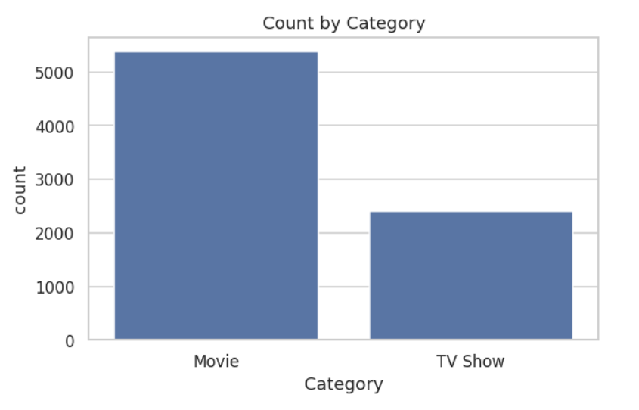
RESULTS1

Slide 7
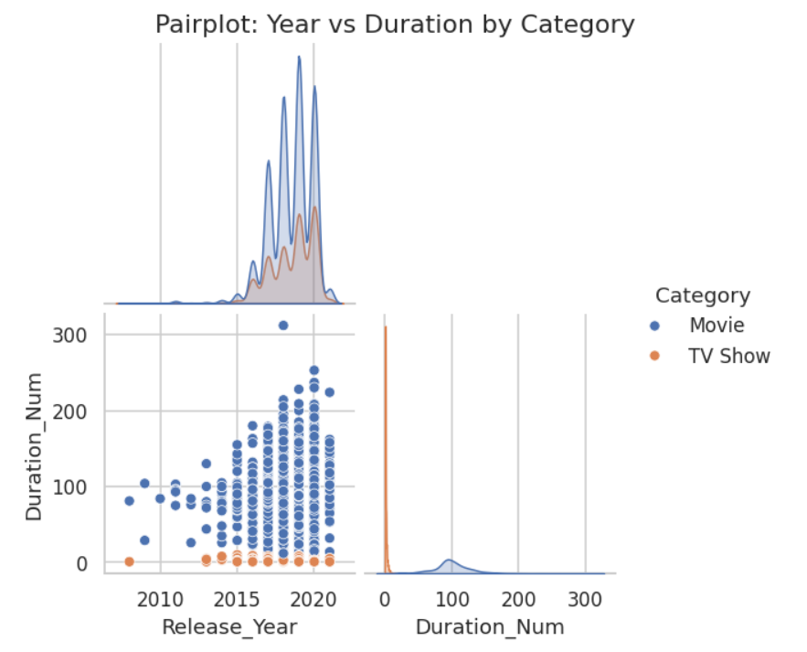
RESULTS2

Slide 8
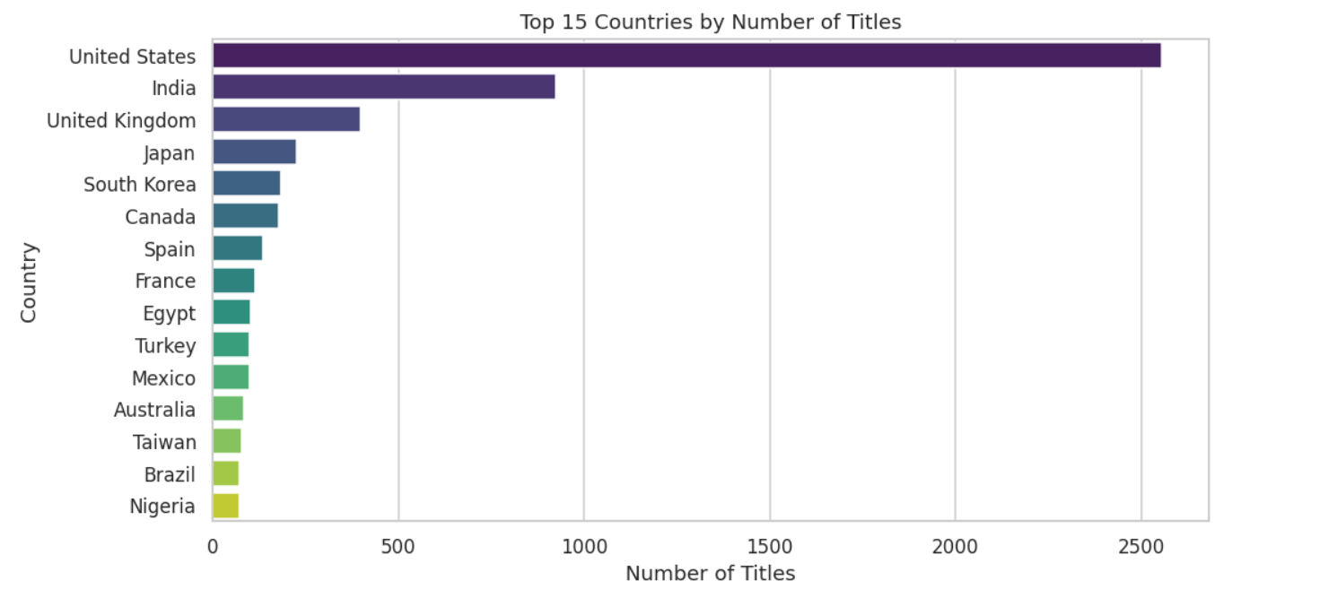
RESULTS3

Slide 9
GitHub repository
https://github.com/aravindpotlapelly/VOIS_AICTE_Oct2025_MajorProject_PotlapellyAravind.git

Slide 10
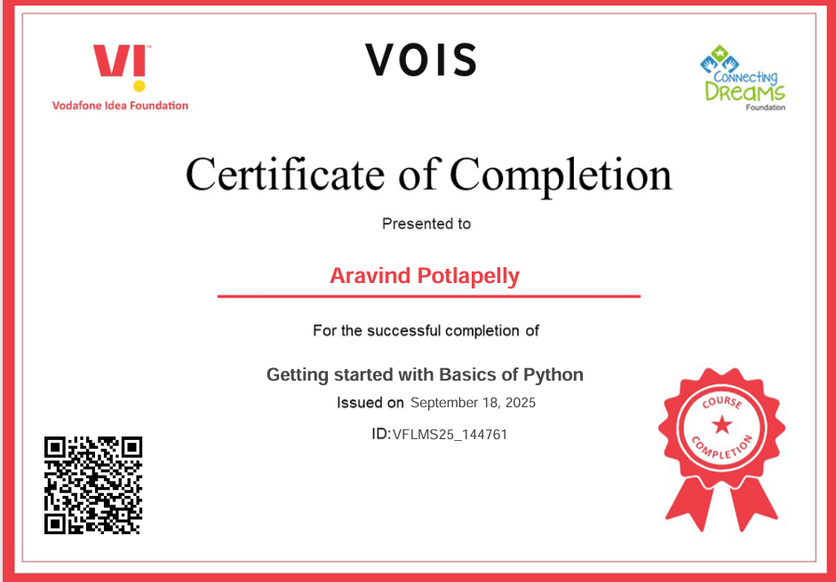
Getting started with Basics of Python Certificate

Slide 11
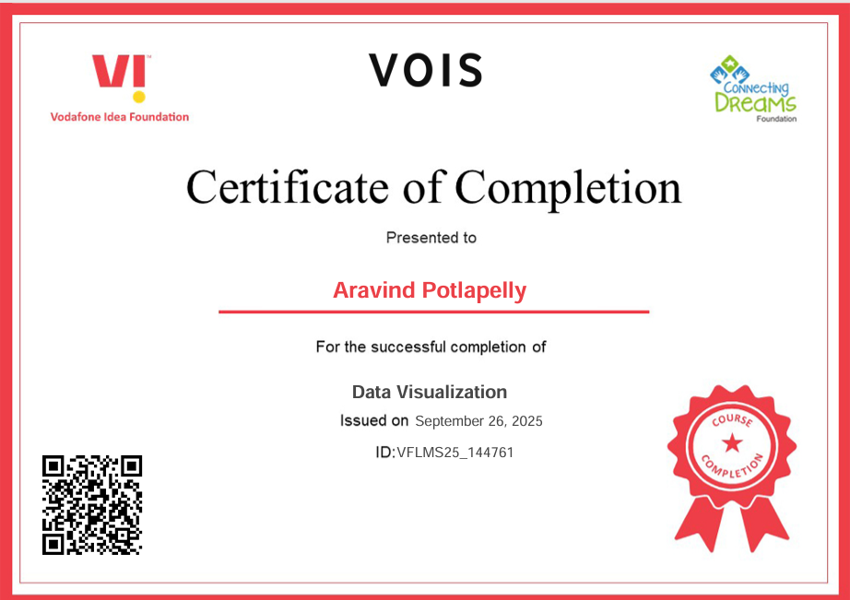
Data Visualization Certificate

Slide 12
Thank you
.
.

